Slide 1
Southeast Asia Urban Development and Water
Water Supply and Sanitation Challenges in SE Asia
Water Security
Antonio Ressano
Principal Urban Development Specialist
Negros Water Summit
28 February 2020

Slide 2
Contents
Asian Development Bank
Water & urban operational footprint
Philippines ongoing projects
Water Districts Development Project
WATSAN situation across SE Asia
WATSAN challenges in Philippines
Water security in Philippines
Water Security – Required Approach
ADB Livable Cities
SE Asia lending program 2020-2023
Philippines Sustainable Tourism Project

Slide 3
Asian Development Bank
General
68 countries, of which 49 are developing member countries
Provision of loans, grants, and technical assistance
Focus on economic development of our DMCs through provision of infrastructure, capacity development, and institutional reform
South East Asia water and urban focus:
Mainly focused on 6 DMCs:
Cambodia, Indonesia, Lao PDR, Myanmar, Philippines, Viet Nam
For other DMCs:
Malaysia - now projects currently being developed
Thailand – limited technical assistance
Recently, Timor Leste was added to our SE Asia portfolio
So main project focus now increased to 8 countries from 2019

Slide 4
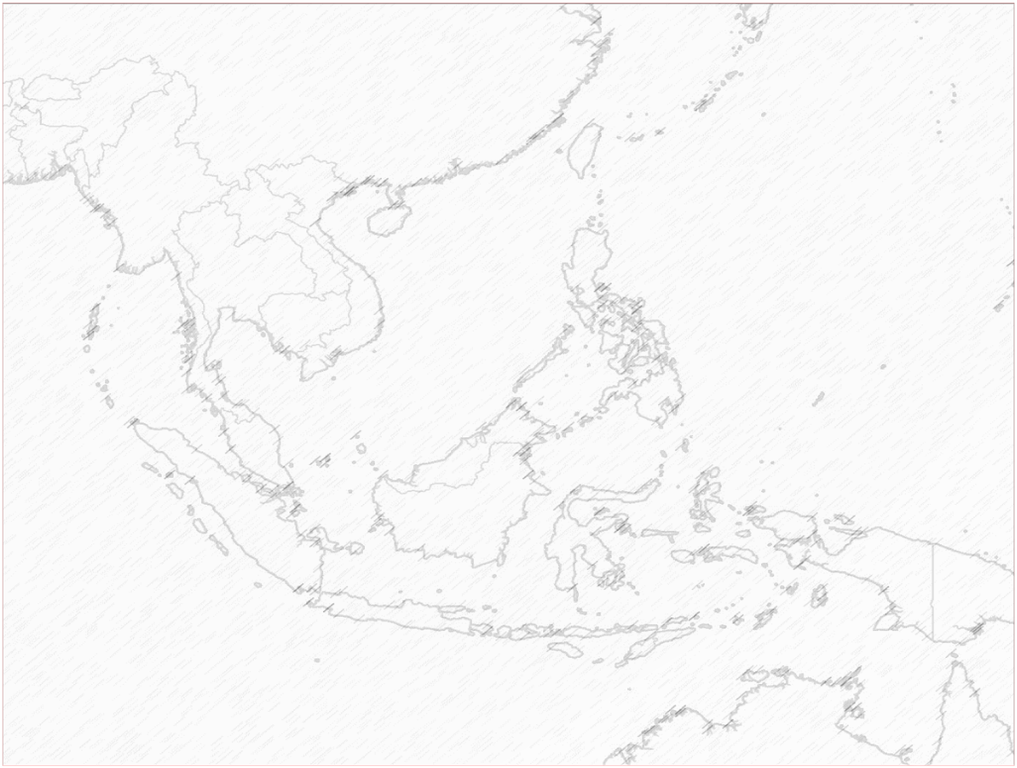
Water & urban operational footprint
MANDALAY
Myanmar
LUANG PRABANG
VIENTIANE
Lao PDR
SAVANAKHET
Philippines
YANGON
PAKSE
Cambodia
MANILA
POIPET
Vietnam
HUE
BATTAMBANG
CORON
SIEM REAP
GIA NGHIA
PHNOM PENH
PHAN RANG
CEBU
KAMPOT
ZAMBOANGA CITY
BAVET
PHAN THIET
GENERAL SANTOS CITY
KEDAH
Malaysia
EL NIDO
PENANG
HO CHI MINH CITY
PUERTO PRINCESA
CENTRAL SULAWESI
SORONG
Indonesia
BANJARMASIN
PALEMBANG
MAKASSAR
DKI JAKARTA
WEST JAVA
BANYUWANGI
CIREBON
Timor Leste
SAME
LOS PALOS
VIQUEQUE

Slide 5
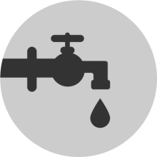
Philippines ongoing projects
PHI: Angat Water Transmission Improvement Project
Loan: $123 million
PHI: Water District Development Sector Project
Loan: $60 million

Slide 6
PHI: Water Districts Development Project
Financed under a $60 million loan and a $2 million grant. The loan and grant agreements became effective on February 2017. The loan and grant are scheduled for closing on October 2022. The EA is the Local Water Utilities Administration (LWUA).
Project Outcome. The project’s expected outcome is increased access to safe drinking water and improved sanitation with about 200,000 more people expected to have access to piped water service connections, and 400,000 more people having access to improved sanitation (by 2023).
Output 1: Water supply systems extended and rehabilitated, and new sanitation facilities constructed.
Output 2: Capacity of participating water districts and LWUA developed. A training program for Institutional Strengthening of Water Districts and Sanitation Training program and information, education and communication materials have been prepared.

Slide 7
Water Districts Development Project
Ongoing sector loan project with LWUA covering 12 water districts:
Bayawan (Negros Oriental) – water supply
Polomolok (South Cotabato) – water supply
Tanjay (Negros Oriental) – water supply
Metro Tiguegarao (Cagayan) – water supply
Sta Maria (Bulacan) – water supply
Zamboanga – water supply and sanitation (sewerage)
Norzagaray (Bulacan) – water supply and sanitation (septage)
Metro Kidipawan (North Cotabato) – water supply
Valencia City (Bukidnon) – water supply
Paridel (Bulacan) – water supply
Manolo Fortich (Bukidnon) – water supply
Metro Cotabato – water supply
Interesting to note that only two WDs are including sanitation

Slide 8
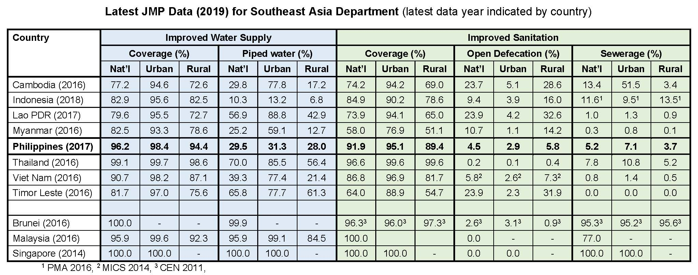
WATSAN situation across SE Asia
Overall WATSAN coverage is relatively high in PHI vs SE Asia, but….
Piped water supply coverage – only 29.5% (and only 31.3% for urban)
Sewerage coverage – only 5.2% (and only 7.1% for urban)
Open defecation – 4.5% (4.9 million people)

Slide 9
WATSAN challenges in Philippines
Water Supply
Over-reliance on groundwater
Low-level of coverage with piped water supply
Piped water quality (potable or not)
Access to sustainable water resources
Water security
Sanitation
Low level of sewerage coverage
Latrines and septic tanks (quality and emptying frequency)
Collection, treatment, and disposal of septage / fecal sludge
Absence of/inadequate wastewater treatment
Open defecation still used by 4.9 million people
Overlap with urban drainage (combined systems)
Overlap with solid waste (drainage and leachate)
For both, operational and financial sustainability

Slide 10
Water security in Philippines
Although the Philippines is not a water scarce country, the availability of water resources is unevenly spread
Water security is an urgent and growing issue, straining infrastructure and services and threatening economic growth:
Population growth
Rapid urbanization (particularly over the last 20 years)
Lack of investment in infrastructure and services and inadequate O&M
Institutional complexity and unclear responsibilities
Over abstraction of groundwater and increasing salinity
Environment degradation and low disaster resilience
Poor health conditions - higher risk of waterborne and water related diseases
Growing towns and cities are finding that local water sources are no longer sufficient and climate change is exacerbating the situation
Urgent action is needed to prevent a national water crisis

Slide 11
Water security – Required Approach
What is water security? UN Definition:
“The capacity of a population to safeguard sustainable access to adequate quantities of and acceptable quality water for sustaining livelihoods, human well-being, and socio-economic development, for ensuring protection against water-borne pollution and water-related disasters, and for preserving ecosystems in a climate of peace and political stability.”
How does this translate into water/urban projects financed by ADB?
Holistic, multi sector and intergated approach is essential
Addressing sanitation is equally important as water supply
Solid waste management and drainage addressed
Inclusiveness is essential
Design for water related disasters (flood and drought)
Design for climate change adaption and/or resilience
Hence, ADB now is focusing on Livable Cities to meet the SDGs

Slide 12
Strategy 2030 - Making Cities More Livable
Urban Sector’s Contribution to the 7 Operational Priorities
OP1| Addressing Remaining Poverty and Reducing Inequalities
Promote social inclusion through affordability and accessibility of urban services, equity, and jobs.
Ensure accessibility for citizens with special needs.
Promote affordability and access of basic services for the urban poor.
OP2| Accelerating Progress in Gender Equality
Facilitate women’s participation in urban planning and governance.
Mainstream gender in urban transport.
Create opportunities for women’s employment and entrepreneurship.
Develop smart technologies for the special needs of women.
Address the needs of women migrants.
OP3| Tackling Climate Change, Building Disaster Resilience
Promote an integrated approach to address climate risks.
Knowledge exchange on climate mitigation and adaptation measures.
Build capacities of cities to utilize climate finance to achieve local environmental improvement objectives.
Link nationally determined contribution frameworks to city-level greenhouse gas accounting.
OP4| Making Cities More Livable
Increase focus on new subsectors including slum development, informal settlements, and affordable housing for social inclusion
Continue focus on gender, climate change, disaster and governance.
Create strong links to create inclusive facilities for urban transport, energy, and health.
OP5| Promoting Rural Development and Food Security
Support rural-urban connectivity.
Advocate innovative information and communication technologies to better link rural-urban economic linkages.
Support food security through improved market integration and connectivity.
OP6| Strengthening Governance and Institutional Capacity
Facilitate the enhancement of citizen-centric approaches and partnerships.
Enhance transparency and accountability of city governance systems.
Improve service delivery and citizen engagement using the latest technologies.
OP7| Fostering Regional Cooperation and Integration
Encourage development of economic city clusters along economic corridors.
Integrate cities into regional value chains and global production networks.
Link border cities in climate action agreements and use of shared infrastructure.
Facilitate cross-border transport flows.
Facilitate implementation of cross-border power purchase agreements.
Promote regional public goods and tourism.

Slide 13
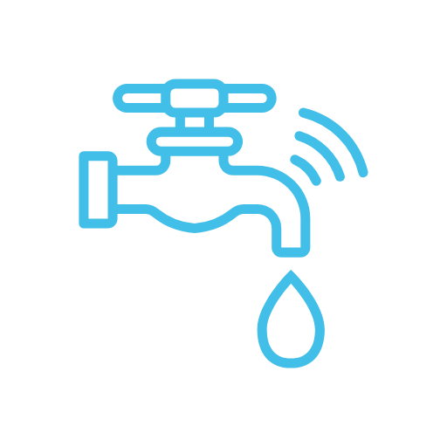
Operational Approaches
Operational Priority 4
Making Cities More Livable
Build capacities and strengthen institutions
Foster integrated city development
Combine policy reforms, capacity development, institutional strengthening, and knowledge management
Develop pilots and leapfrog to the latest technologies
Prepare and implement smart city plans.
Enhance city competitiveness and productivity.
Support localization and implementation of Sustainable Development Goals.
Support infrastructure and services in urban areas.
Scale up the use of proven digital technologies
Ensure water security and adequate waste management
Provide energy security.
Promote public mass transport.
Support pro-poor and inclusive cities with social services, and safe and healthy urban environments.
Prepare integrated urban plans
Support inclusive and participatory planning.
Use differentiated approaches to different categories of cities
Support cities to maximize their internal financial resources.
Promote land-based financing.
Develop innovative external sources of financing
Support utilities and service providers to develop PPPs
Support urban governance improvement of utilities
Support environment improvement projects
Promote energy-efficient and environment-friendly technologies and processes
Support risk-sensitive land use management
Promote circular economy practices
Adopt nature-based solutions.
Support resilient cities
Strengthen disaster preparedness and emergency response plans
Support cities to localize nationally determined contributions (NDCs)
Adopt a systems approach to urban infrastructure resilience
Subpillars
Performance of urban and social services service providers improved
Provision of urban infrastructure and services improved
Strategic Operational Priorities
1
Improve coverage, quality, efficiency and reliability of services in urban areas
2
Strengthen urban planning and financial sustainability of cities
Regulatory, legal and institutional environment for more inclusive planning improved
Reforms and policies for improved financial sustainability of cities implemented
3
Improve urban environment, climate-resilience and disaster management of cities
Urban environment improved
Capacity of cities for climate resilience and disaster risk management improved
Implementing integrated solutions to achieve green, competitive, inclusive, and resilient cities

Slide 14
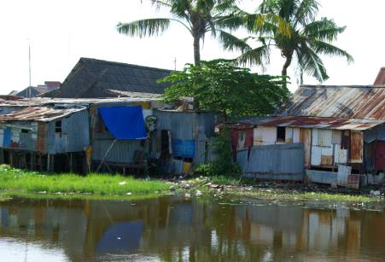
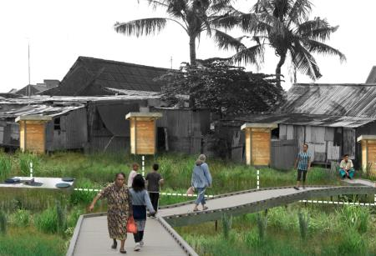
Technology solutions
Testing nature-based solutions as alternatives for water conservation
Makassar, Indonesia and Hue, Vietnam
Using advanced construction techniques and high value engineering
Metro Manila, Philippines; Ho Chi Min City, Vietnam; and Yangon, Myanmar

Slide 15
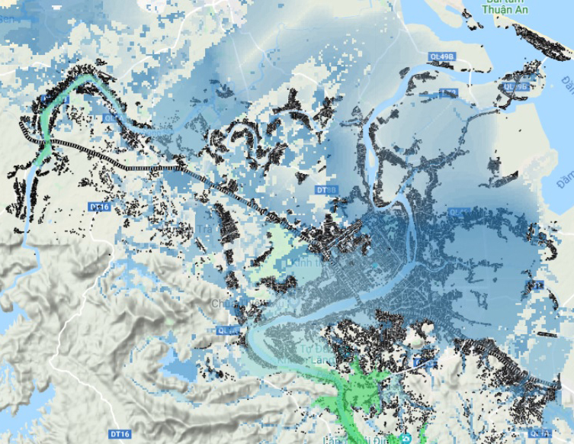
Digital solutions
Building footprint, Hue
Flood depth in 1980, Hue
Flood depth in 100 years, Hue
Using earth observation and climate forecast for data capture, analysis, planning, and design
Mandalay, Myanmar; Palembang, Indonesia; Hue, Vietnam; El Nido and Coron, Philippines

Slide 16
Gross National Income Per Capita of 3 Developing Member Countries
Finance solutions
Ownership-based Classification of Water Supply Companies (Viet Nam)
Performance-based Classification of PDAMs (Indonesia)
Credit-worthiness-based Classification of Water Districts (Philippines)
17
MOC Consulting Report, Vietnam (2017)
MPWH, Indonesia (2019)
DOF, Philippines (2005)
Developing Alternative Instruments for Lending to well performing water utilities
Collaboration with PSOD in Binh Duong, Vietnam

Slide 17
SE Asia Lending program
Livable cities
Water resilience
Gender
2020
2021
2022
2023
CAM
Livable Cities
Investment Project
180
Revitalization of Informal Settlements & their Envt.
Livable Cities
Investment Project
Sewerage and Sanitation Investment Project
Livable Cities
Investment Project - 2
INO
3
100
125
100
Water Supply Sector Project
Livable Cities
Investment Program - 1
Livable Cities
Investment Program - 2
Livable Cities
Investment Program - 3
LAO
61
40
35
35
Women-led Water Resilience Project
40
MYA
Yangon City Water Resilience Project
Yangon City Water Resilience Project (AF)
180
150
Angat Water Transmission Improvement Project (AF)
PHI
126
Sustainable Tourism Development Project
Sustainable Tourism Development Project - 2
100
100
Binh Duong Water Resilience Expansion
Secondary Cities Env. Improvement Project
HCMC Climate Resilient Project – 2
VIE
8
175
300
HCMC Climate Resilient Project – 1
360
Kedah Water Resilience Project
Penang Flood Risk Management Project
MAL
50
50
TIM
Water Supply & Sanitation Investment Project
Water Supply & Sanitation Investment Project – 2
Dili Water Supply Investment Project
50
50
75
~$500 million
~$1 billion
~700 million
~$200 million

Slide 18
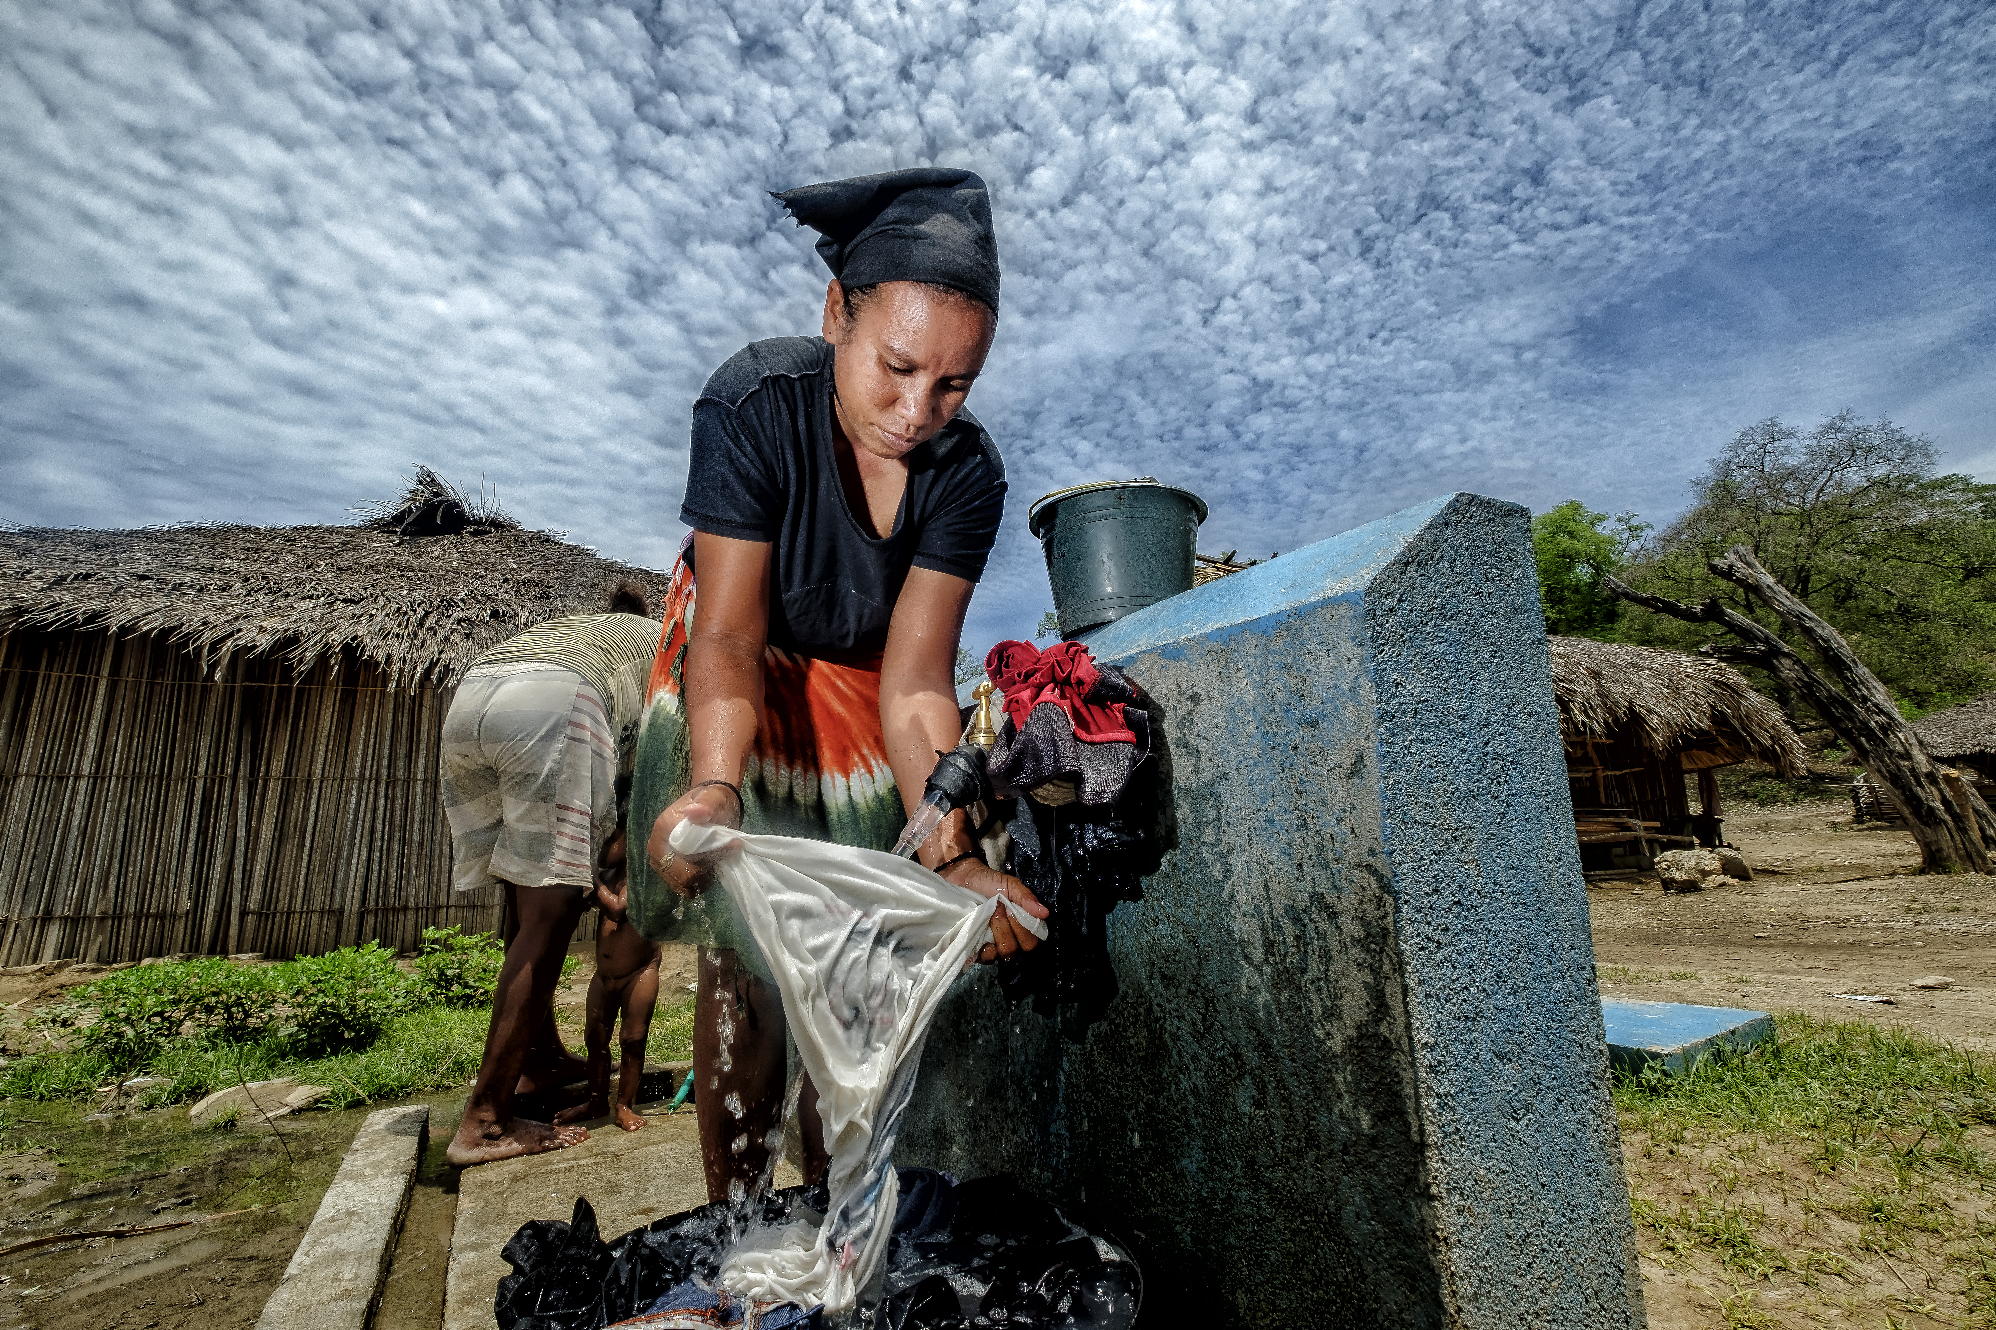
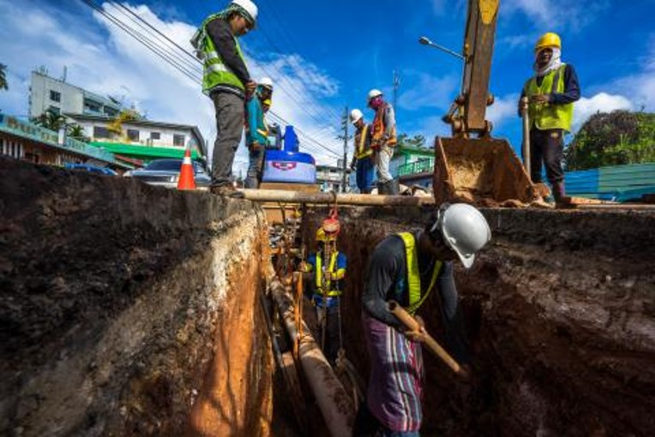
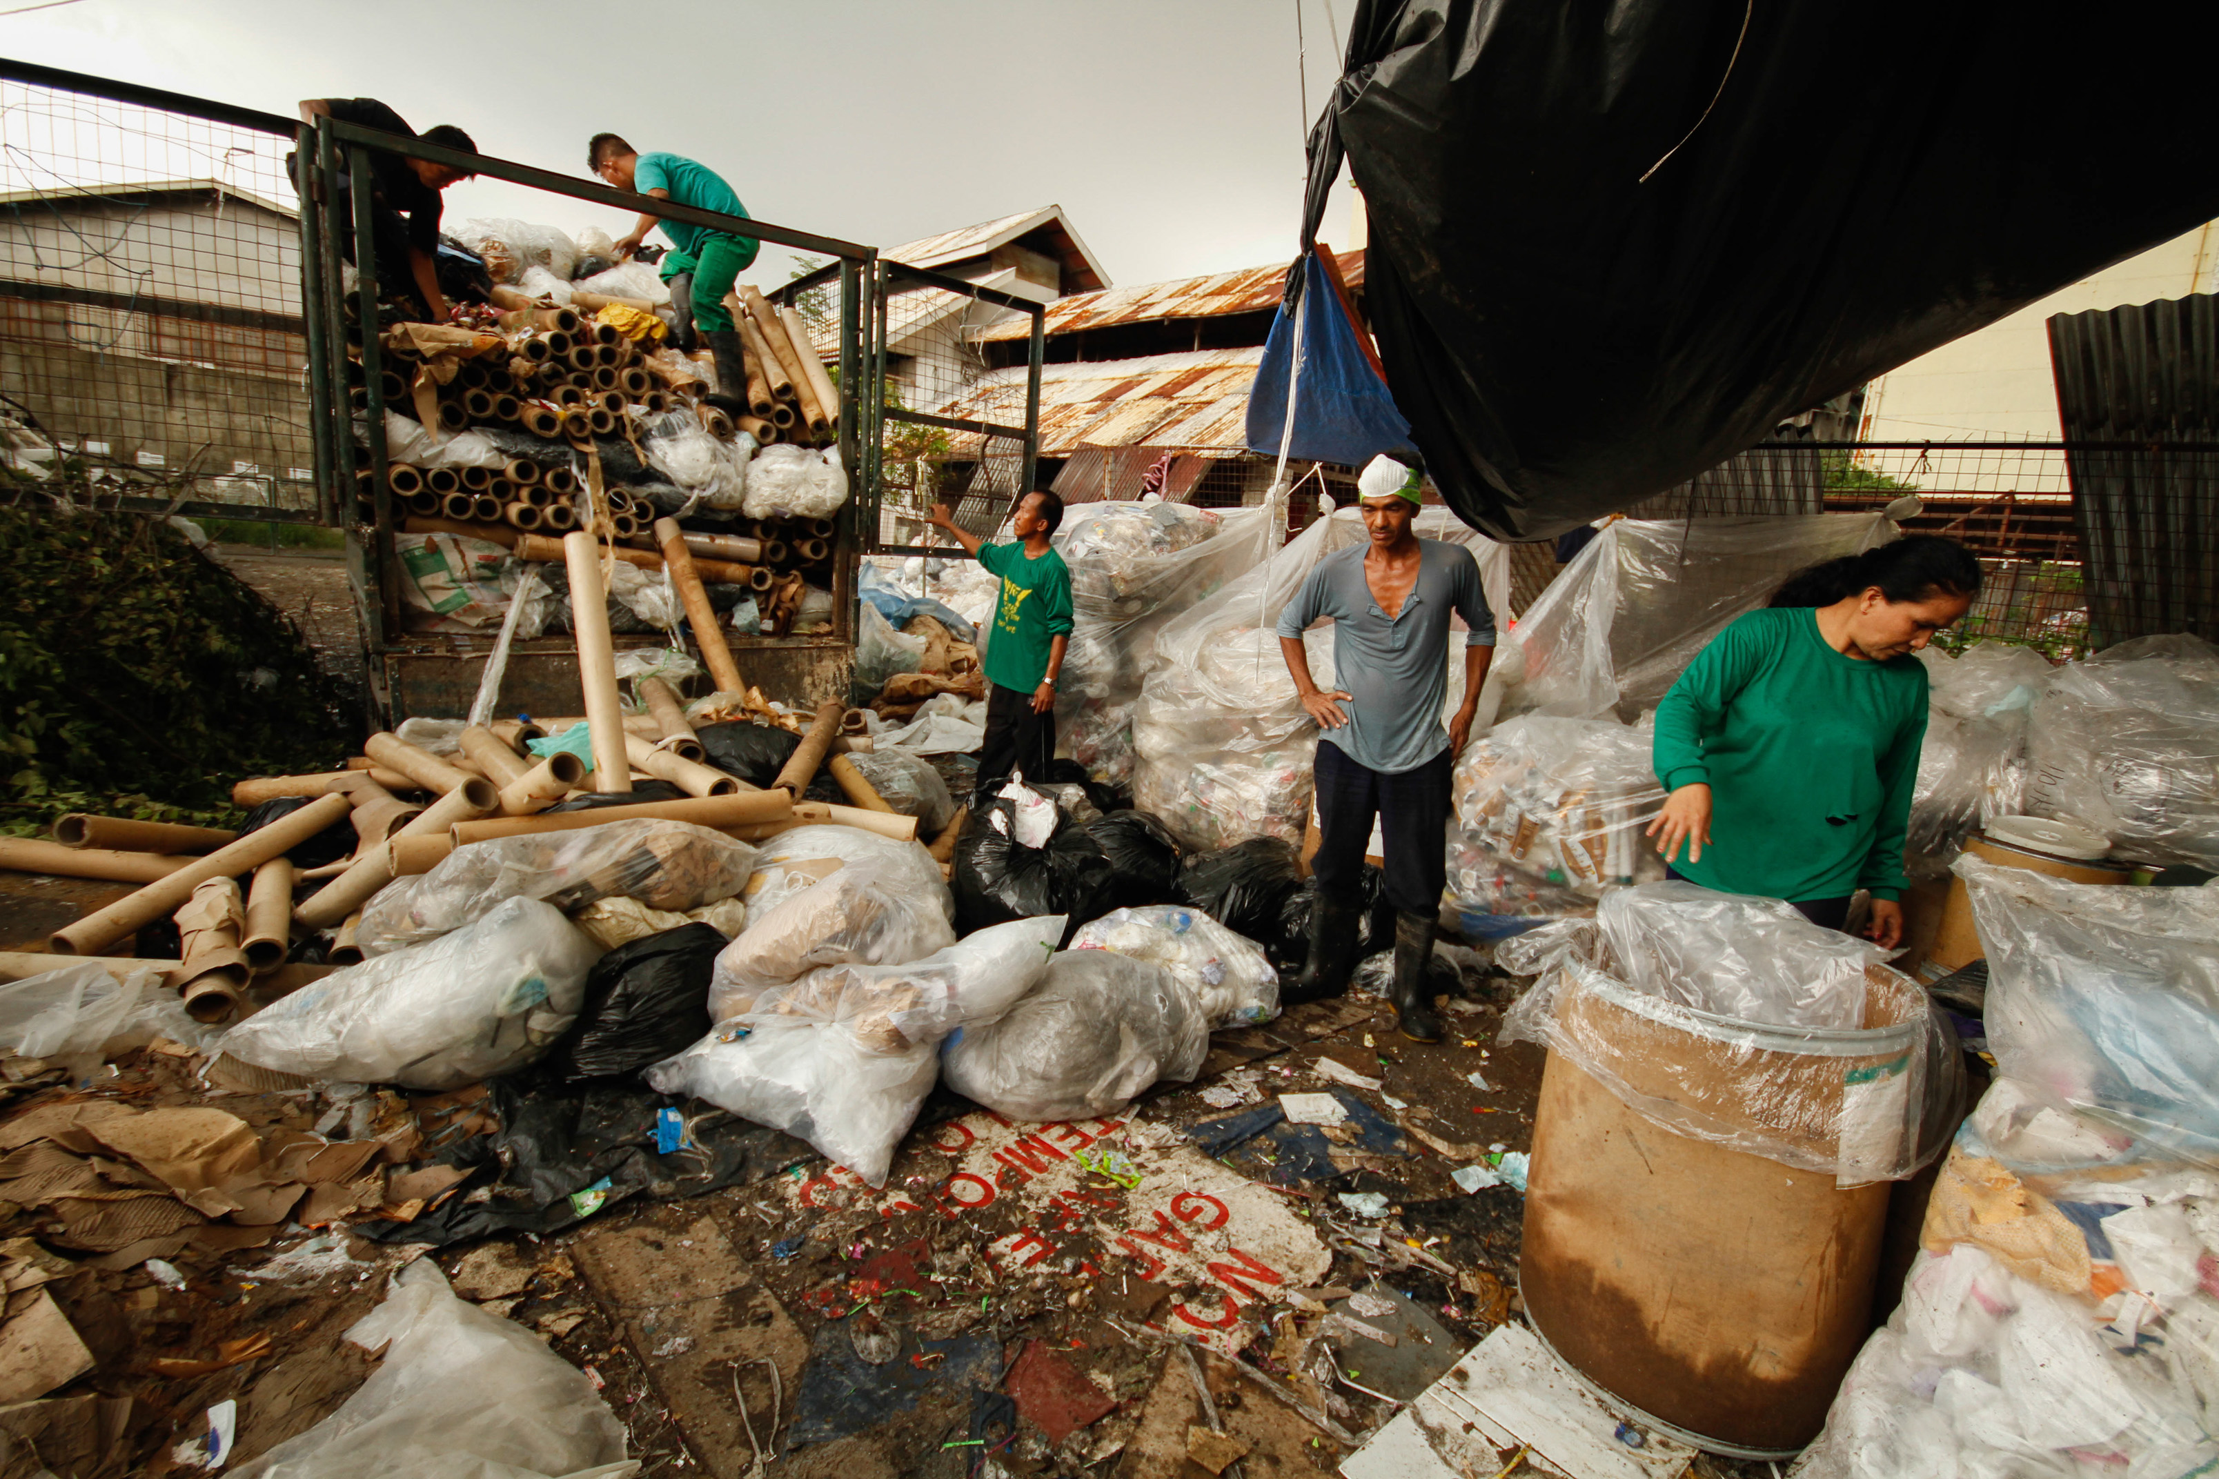
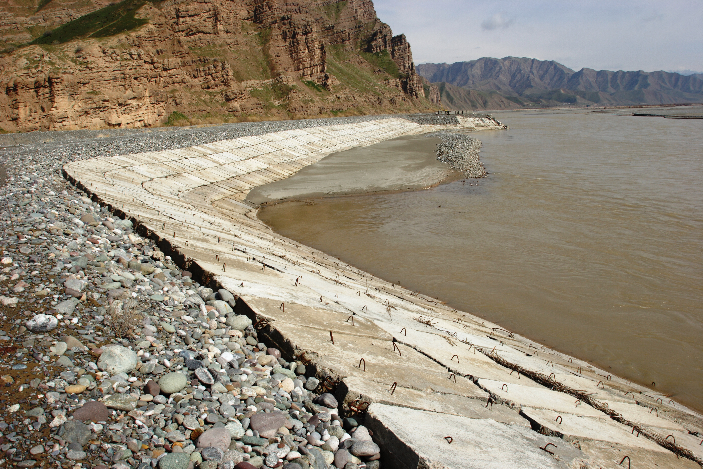
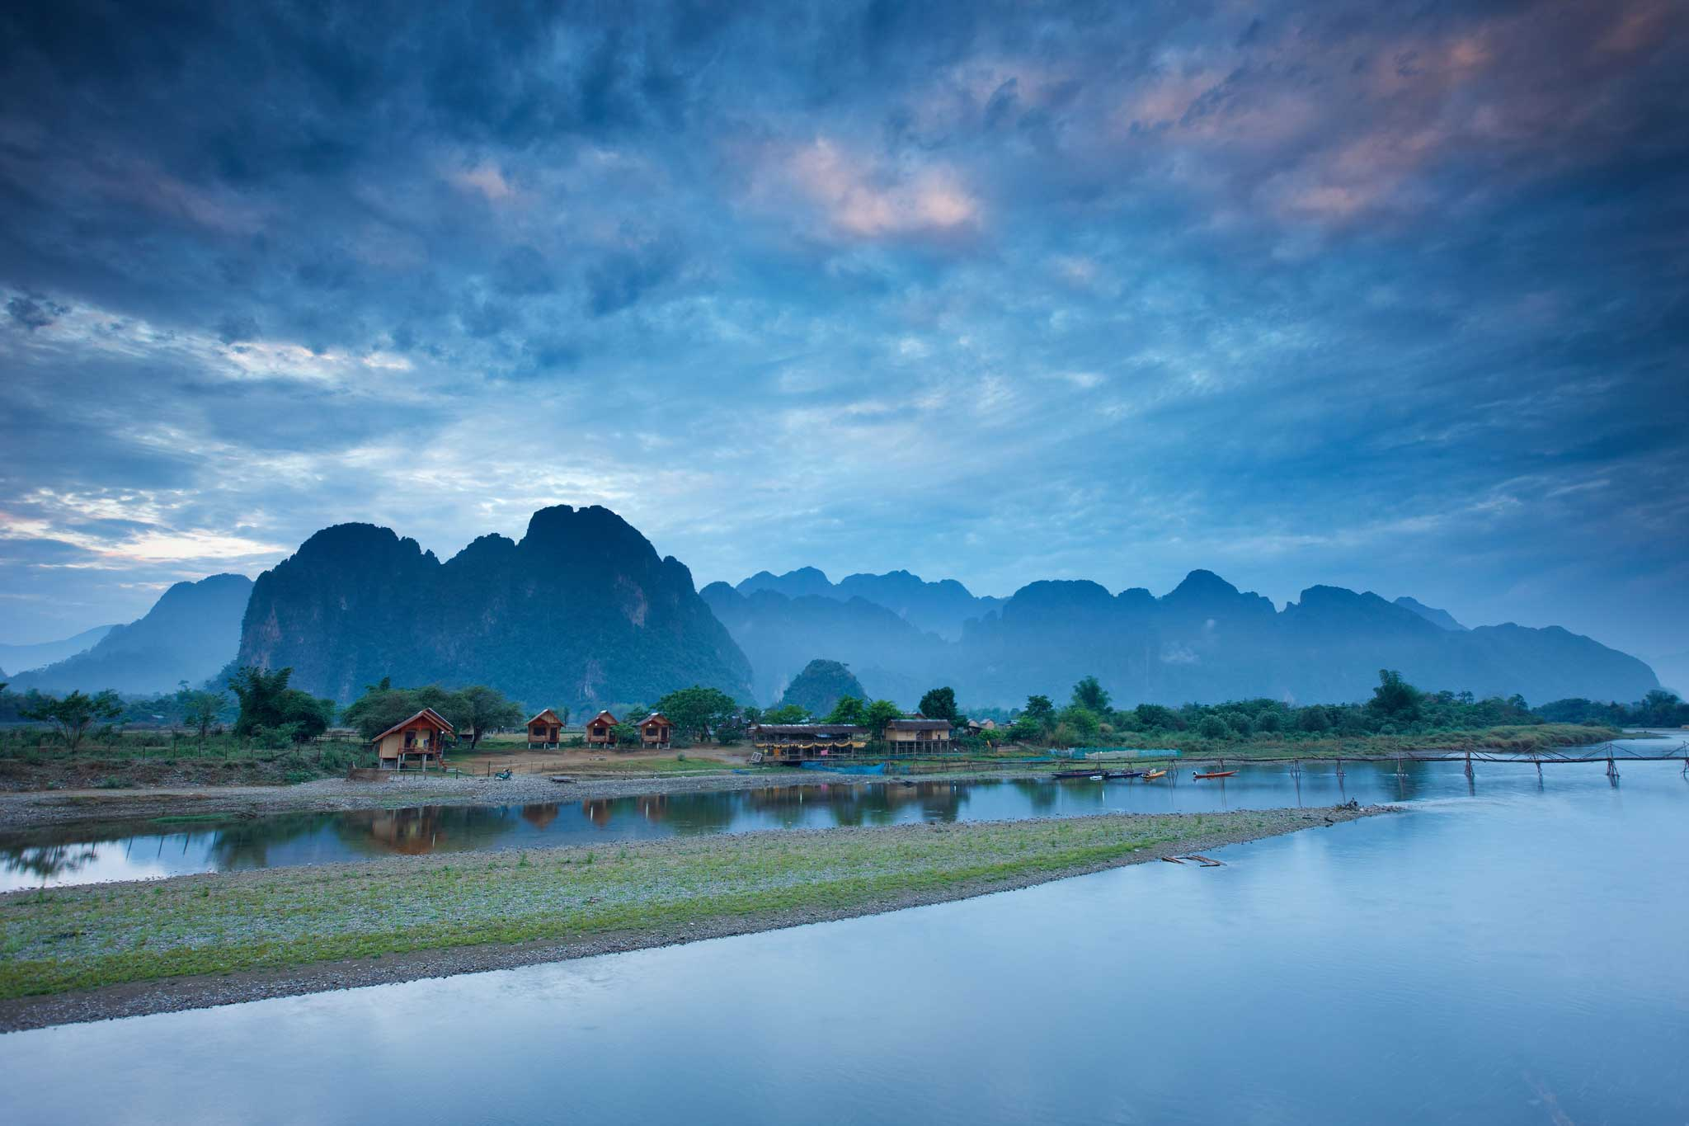
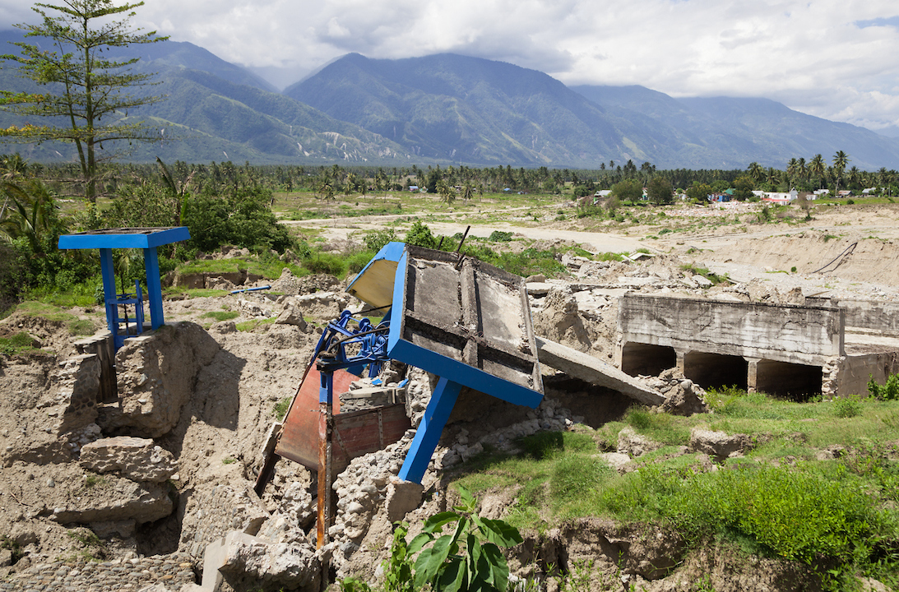
Philippines Sustainable Tourism Development Project
Water resilience
Wastewater and sanitation
Municipal waste management
Ecosystem protection
Sustainable tourism
Conflict and disaster response
18

Slide 19
Project Outcome and Outputs
Outcome | Sustainable tourism development for El Nido and Coron
Output 1 | Improved urban services and infrastructure in El Nido and Coron towns: Water supply, sanitation and drainage Solid waste management Tourism facilities and urban design
Output 2 (gov. funds) | Improved inland connectivity Access roads to gateways (airports and seaports)
Output 3 | Sustainable management of natural resources and enhanced resilience to disasters: Ecosystem protection; livelihood improvement Awareness raising; capacity building Disaster risk management and reduction planning and implementation
Output 4 | Enabling environment for sustainable tourism development Enterprise-based skills development Tourism and urban planning, monitoring and reporting
Output 5 | Improved access to health services Equipment and skills in municipal health units Facilities upgrade Training programs to recruit and retain staff in provincial hospital

Slide 20
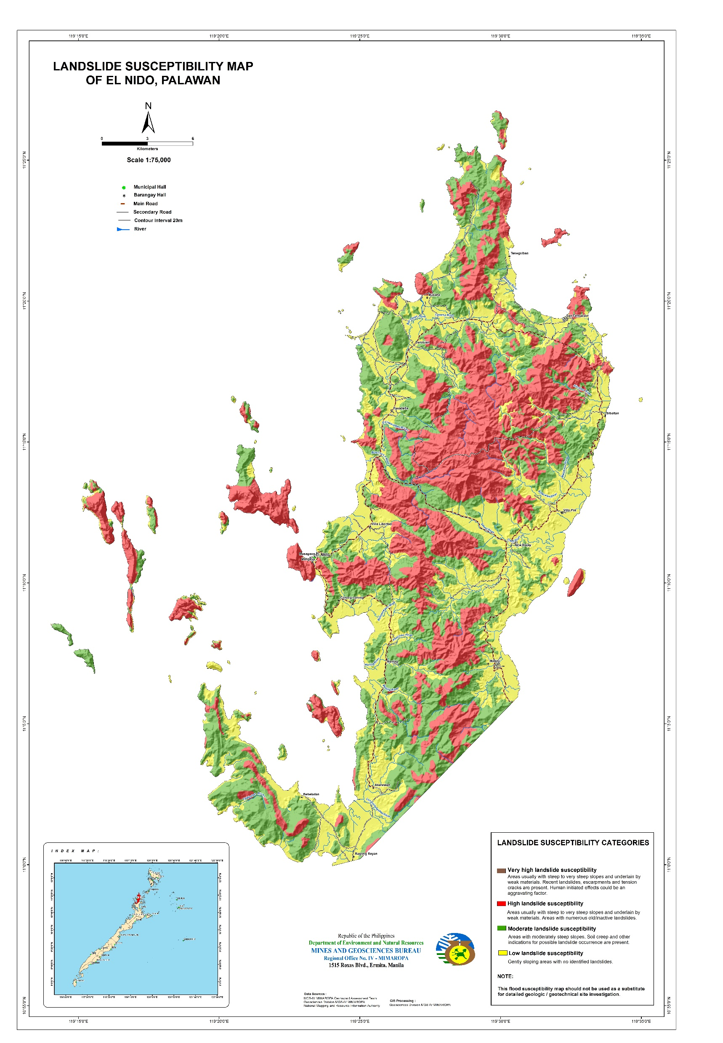
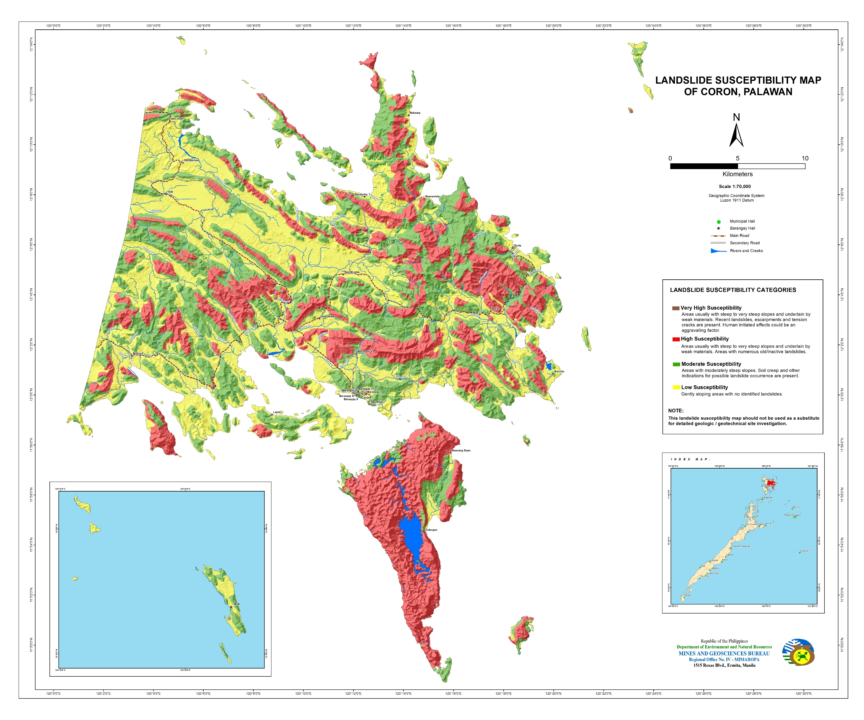
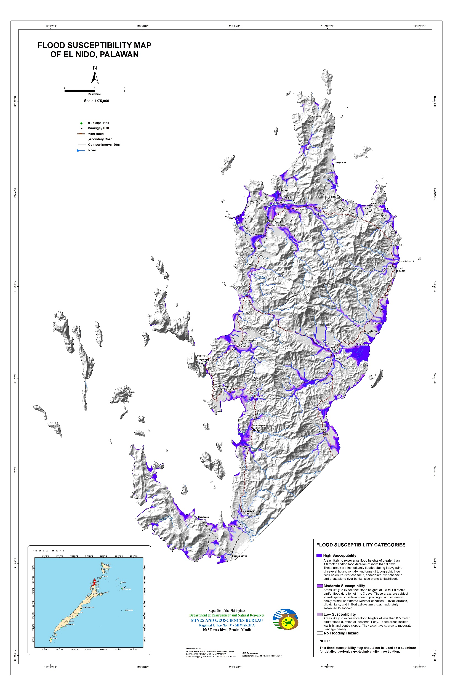
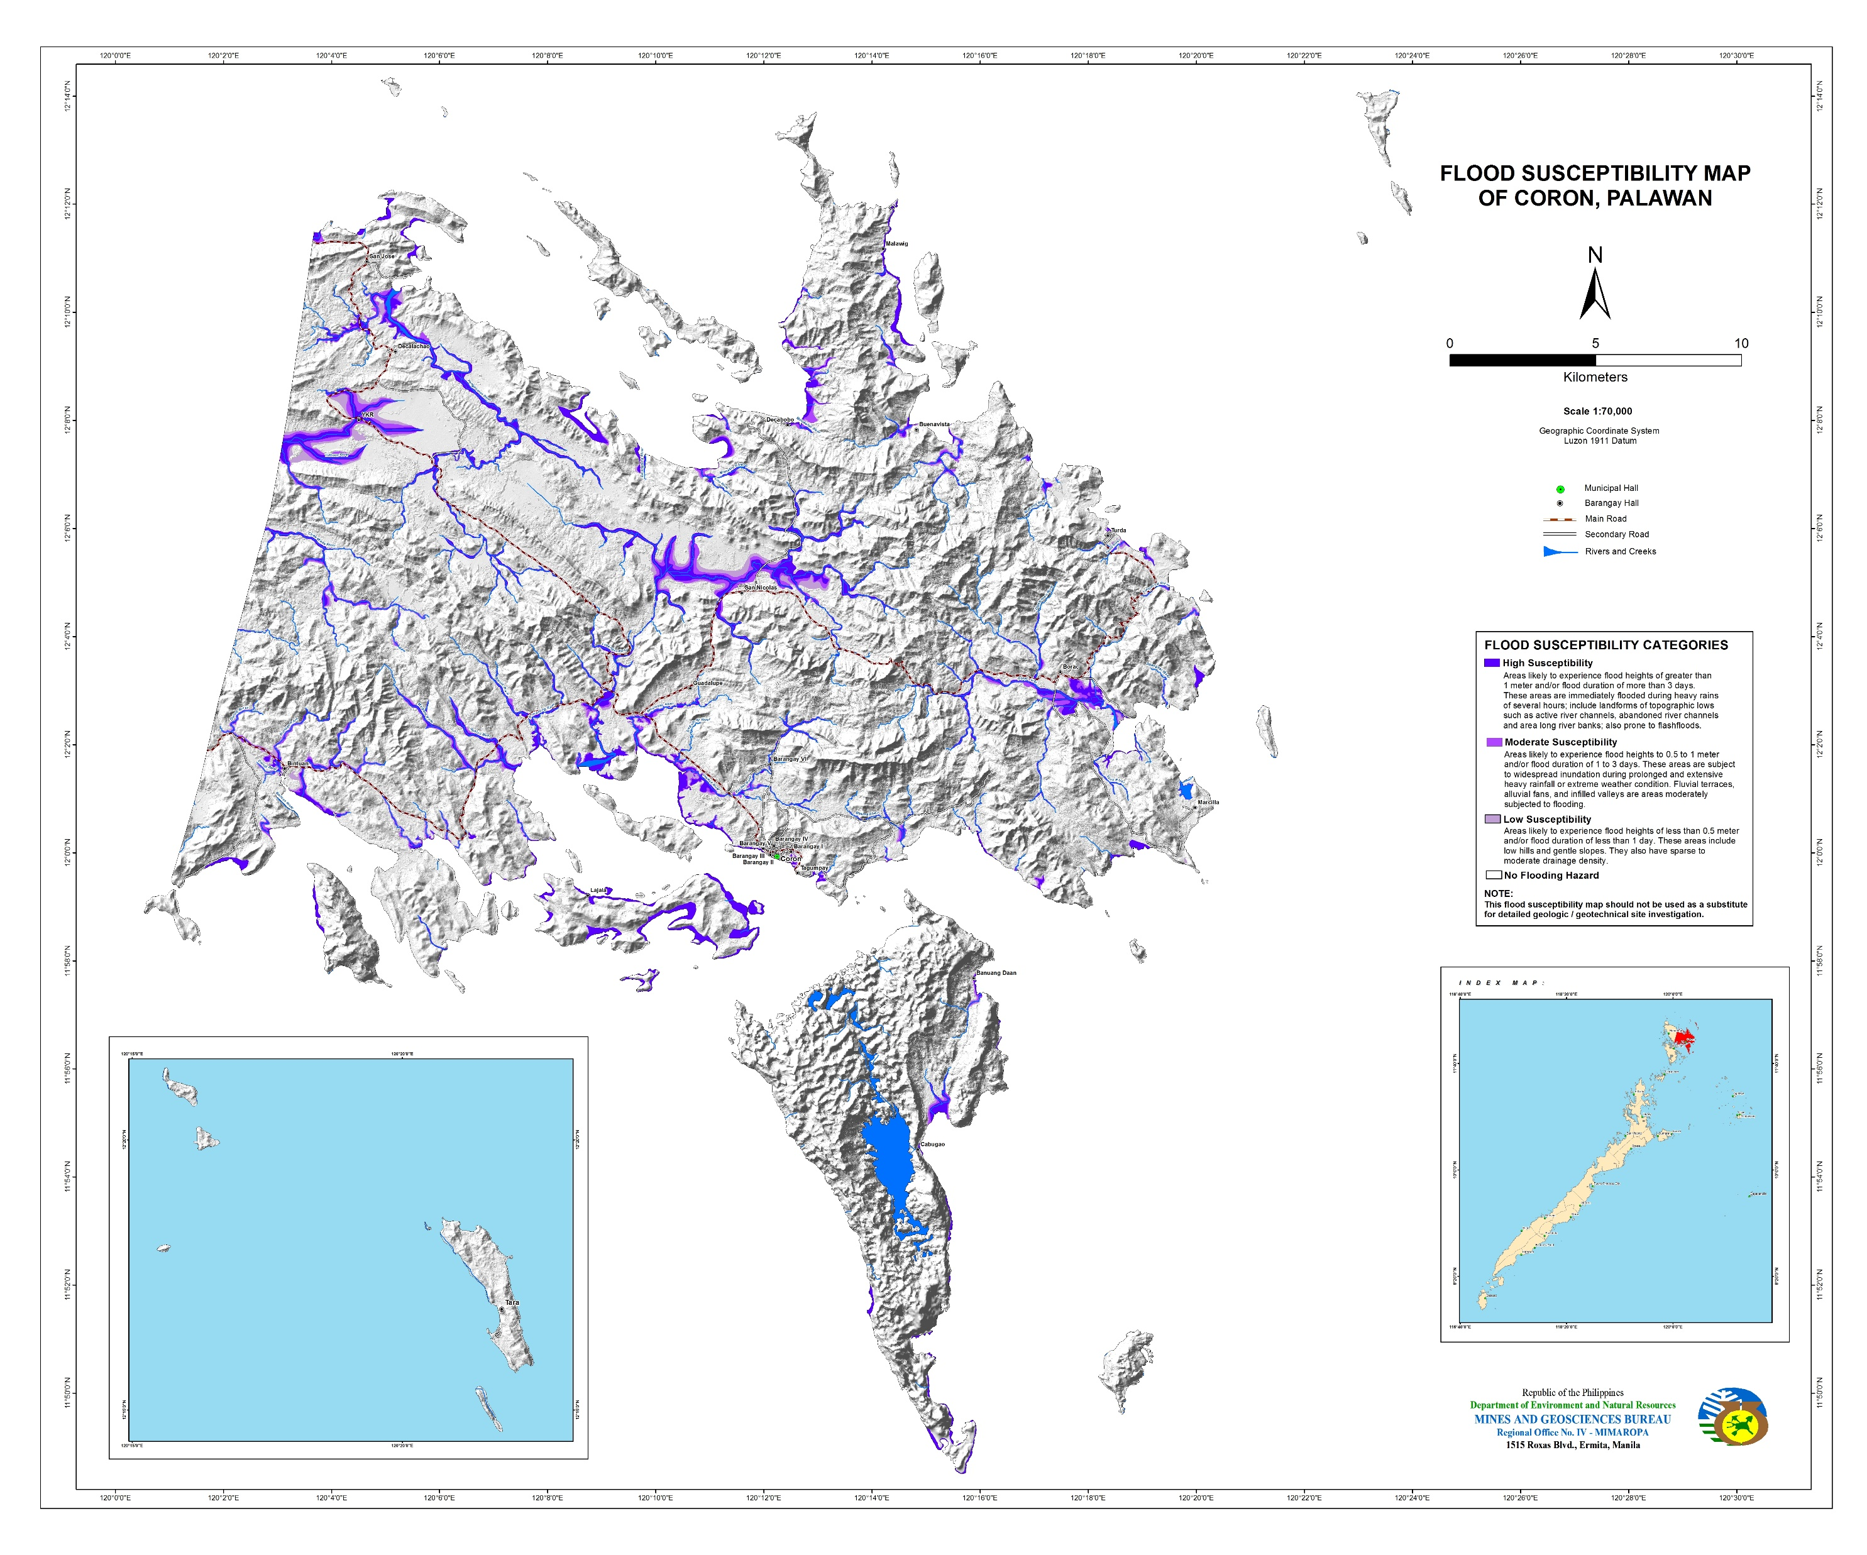
Smart solutions
Digital solutions – using Earth Observation for analytics for growth, climate change and land-use planning
Conservation solutions – improving ocean health supporting SDG 14 (Life Below Water) as the backbone for sustainable tourism
Financial solutions – ensure sustainability of O&M for infrastructure; improving city and utility creditworthiness.
El Nido
Coron
El Nido
Coron
(Above) Landslide susceptibility maps of El Nido and Coron
(Bottom) Flood susceptibility maps of El Nido and Coron

Slide 21
Southeast Asia Urban Development and Water
Contacts:
Vijay Padmanabhan, Director
vpadmanabhan@adb.org
Michael White, PAU Head
mewhite@adb.org
Antonio Ressano
aressano@adb.org

